Slide 1
Language: overview of the computational problem

Slide 2
The goal of this video
A taste of the problems we need to solve to deal with language: learn it, understand it, and produce it
One important take-home message: language has different properties from other domains we deal with in artificial intelligence (and some similarities, too)

Slide 3
Syntax
How can we combine words to form phrases and sentences? What interpretations can these sentences have?
*I pizza like
I like pizza
The dog bit the man: who did the biting? How do we know?
old men and women: two possible interpretations

Slide 4
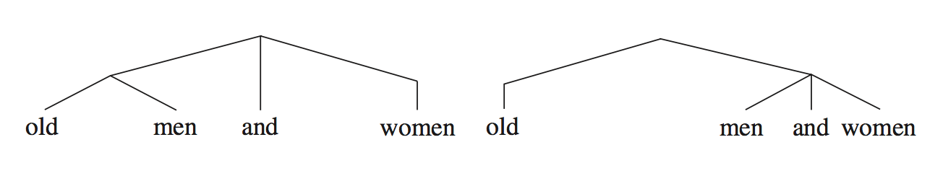
Syntax
Trees illustrate how words are grouped:
Do not always have an acoustic correlate in the speech signal (though sometimes they do: prosody)
Hypothesis: these trees are the representations that humans use for syntax

Slide 5
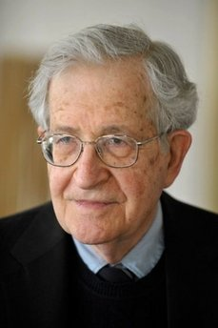
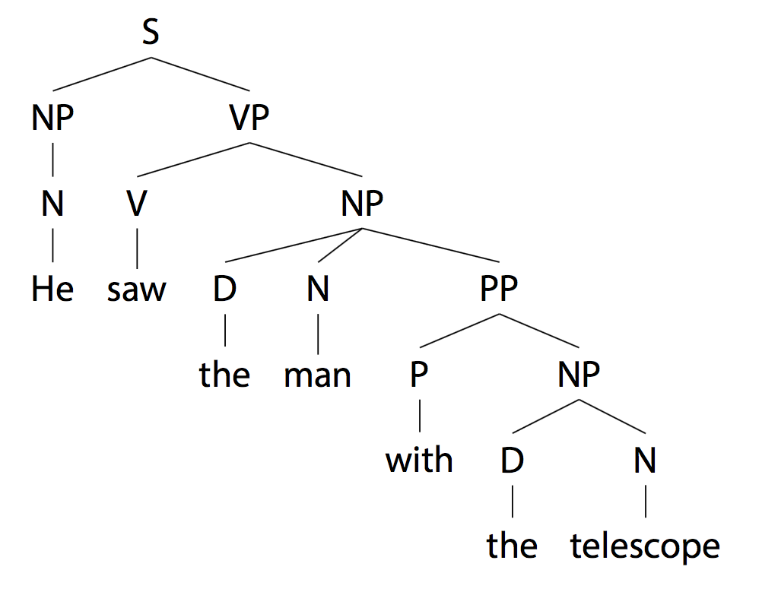
The need for internal representations in language
He saw the man with the telescope
“Which man?” / action / behavior…

Slide 6
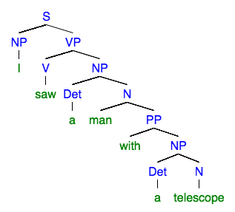
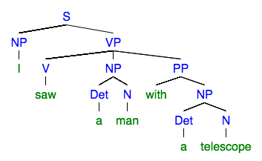
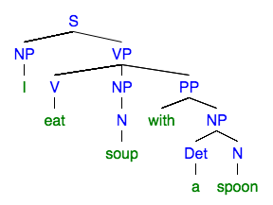
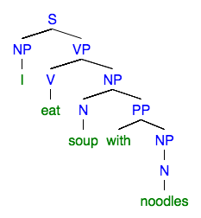
I saw a man with a telescope
I eat soup with a spoon
I eat soup with noodles

Slide 7
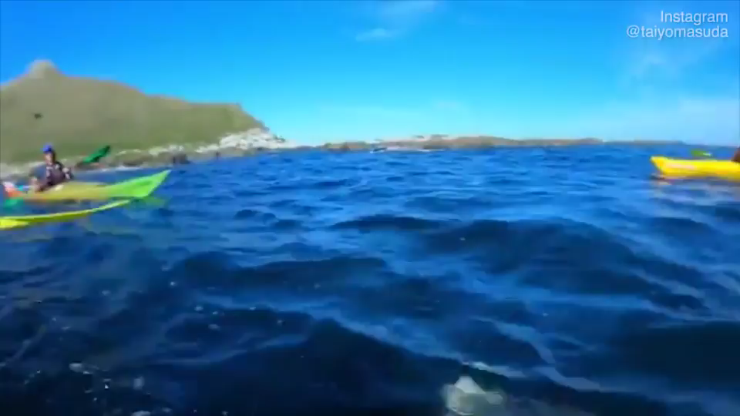
A seal is slapping a man with an octopus

Slide 8
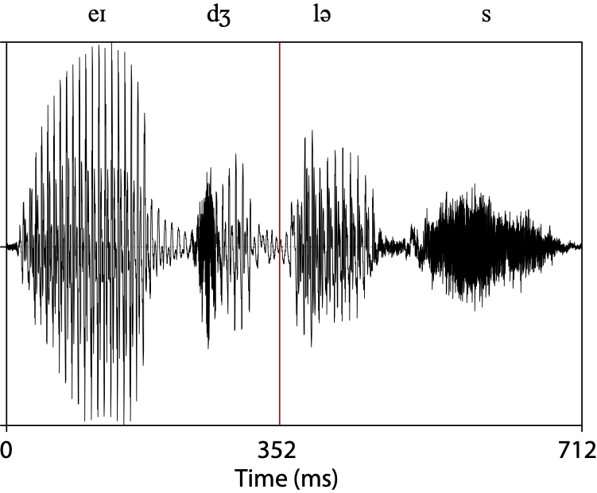
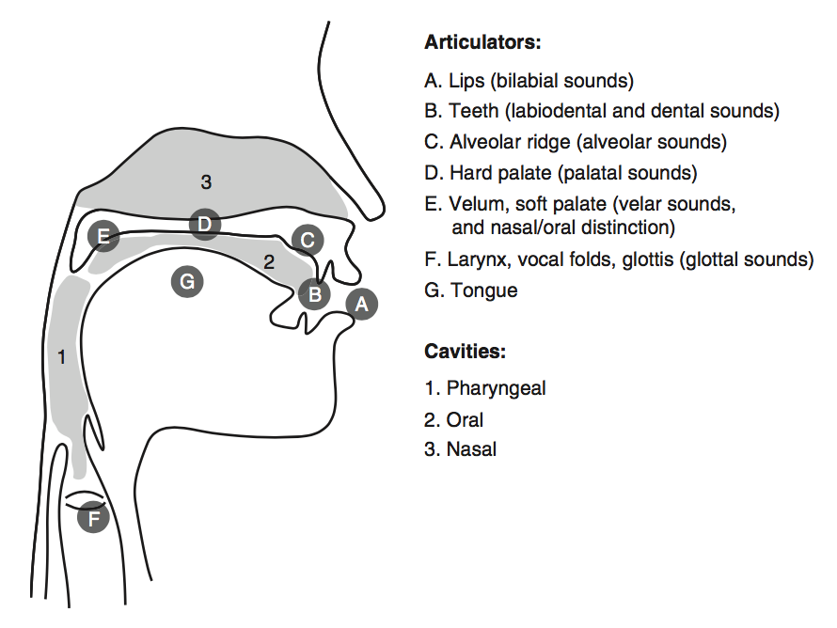
Phonetics
From the continuous speech signal to discrete phones (and back):

Slide 9
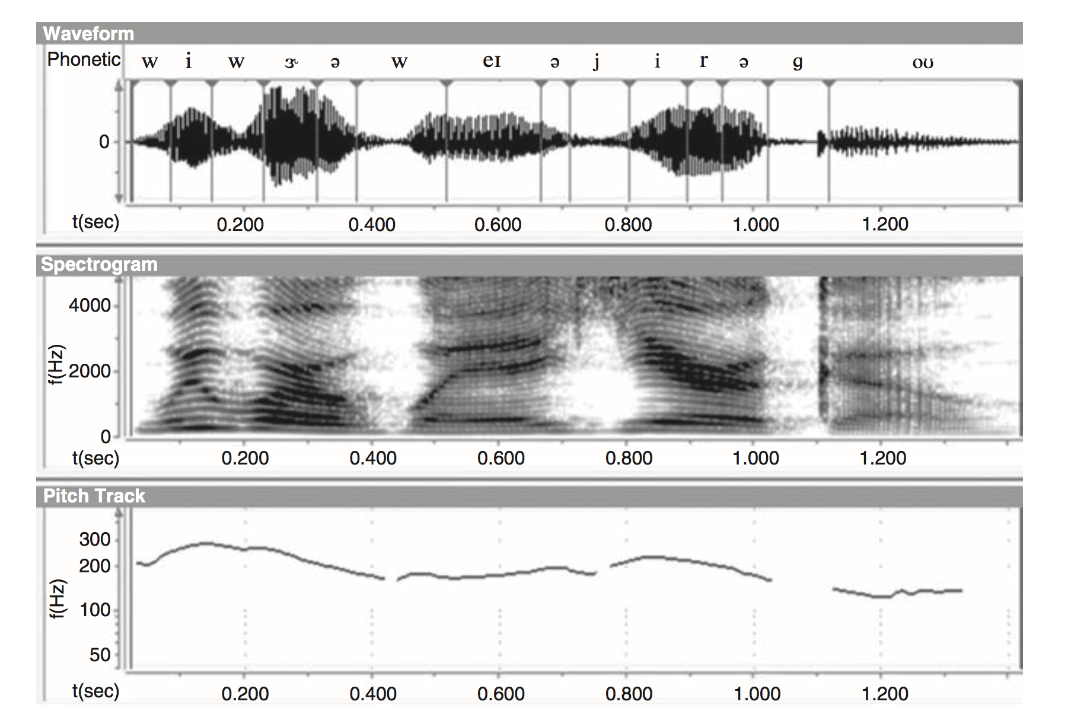
Challenges in speech perception: no pauses between segments and words
“We were away a year ago”

Slide 10

No pauses between segments and between words
Mandarin, unsegmented:
Mandarin, segmented:
Farsi, unsegmented:
Farsi, segmented:
http://sites.sinauer.com/languageinmind/wa04.01.html

Slide 11
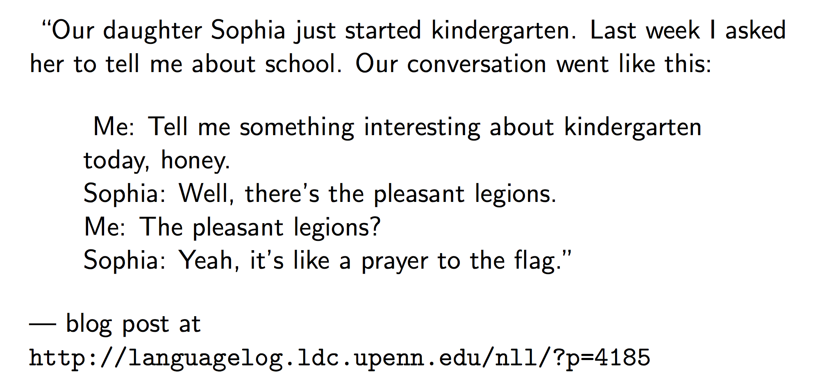
Mapping speech to words is hard

Slide 12
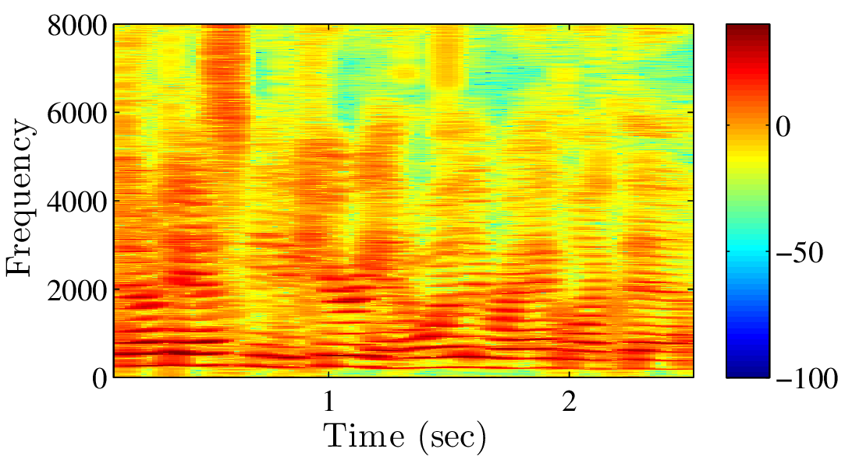
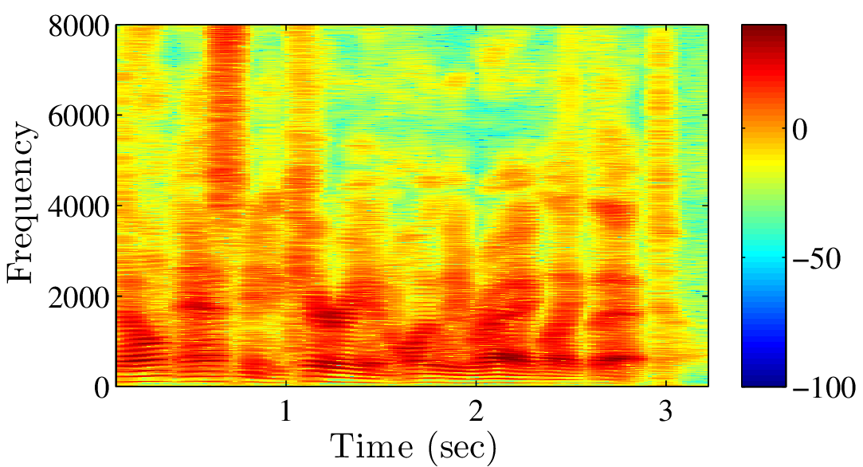
The lack of invariance problem
What are the differences?

Slide 13
Sources of variability in speech
Speech rate
Accent
Individual anatomical differences
Maybe you just got a wisdom tooth pulled
Ambient noise

Slide 14
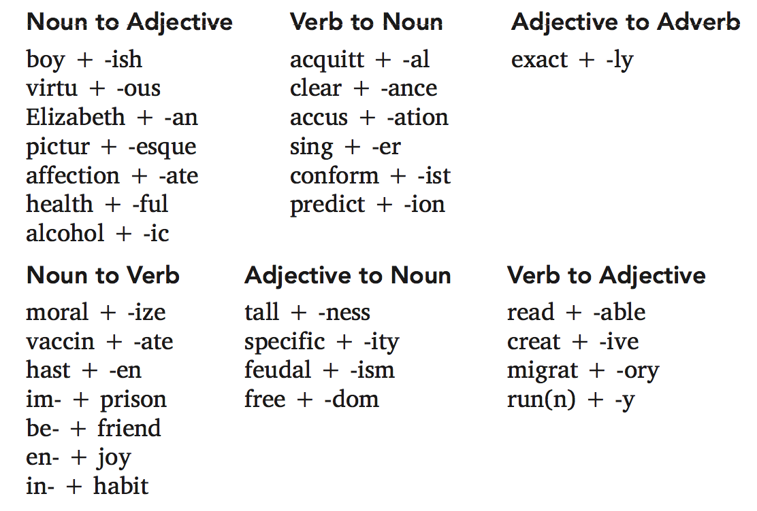
Morphology
A morpheme is the smallest meaning-bearing or function-bearing unit
How many units does the word boyish have?
The stem boy + the suffix -ish

Slide 15
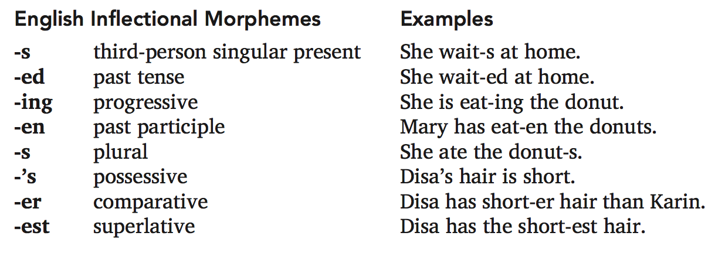
Morphology
Inflectional morphology:

Slide 16
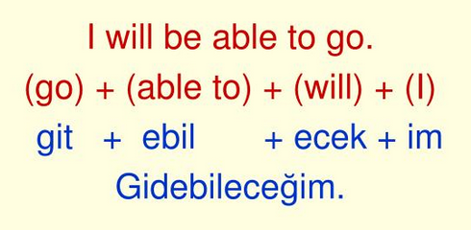
Morphology
(Turkish)

Slide 17
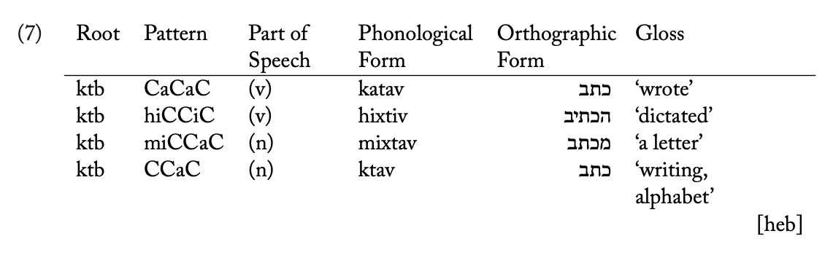
Morphology
(from Bender 2013)

Slide 18
Lexicon and grammar
The lexicon is a (finite) list of units (e.g., words or morphemes) that can be combined to create an infinite number of sentences
The grammar defines the rules by which these units can be combined: not every combination is allowed

Slide 19
Aside: senses of the word grammar
Prescriptive: Lays down the “proper” or “correct” ways to speak
Descriptive: Describes how people actually speak
The internal representations we (humans / AI) use to process language

Slide 20
Semantics
What do words and sentences mean?
Can these particular two words, or sentences, be used in similar contexts, to achieve similar goals?
Which inferences are licensed by a sentence?
All of the students are happy → None of the students is unhappy

Slide 21
Syntax vs. semantics
Do we even need syntax if we have semantics?
Colorless ideas sleep furiously
We know this sentence is well-formed even though it’s not clear what it means
*I likes pizza
A sentence can be unacceptable even if the meaning is clear

Slide 22
Creativity of language
How many sentences are there in English?
I like pizza.
My friend said that I like pizza.
My mother thinks that my friend said that I like pizza.
My mother thinks that my friend said that I like pizza but what my friend actually said is that I do not like pizza.

Slide 23
A seal is slapping a man with an octopus

Slide 24
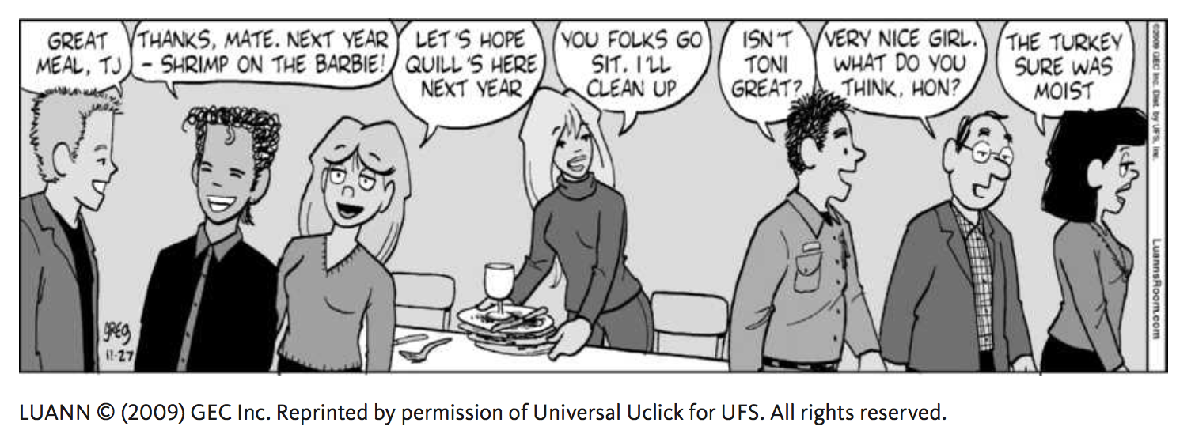
Pragmatics
The intended meaning is often different from literal meaning
Why are people saying what they’re saying?

Slide 25
Variation
Many different dialects of English and accents in the United States (and in other English-speaking countries)
No clear distinction between language and dialect (though mutual intelligibility is a useful criterion)
Everyone has an accent and speaks a dialect
Variation poses a computational problem

Slide 26
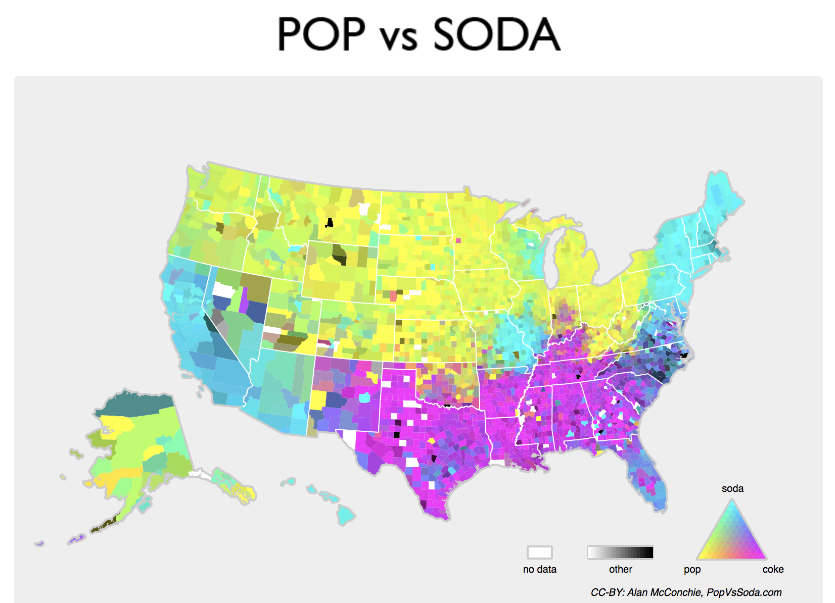
Lexical variation

Slide 27
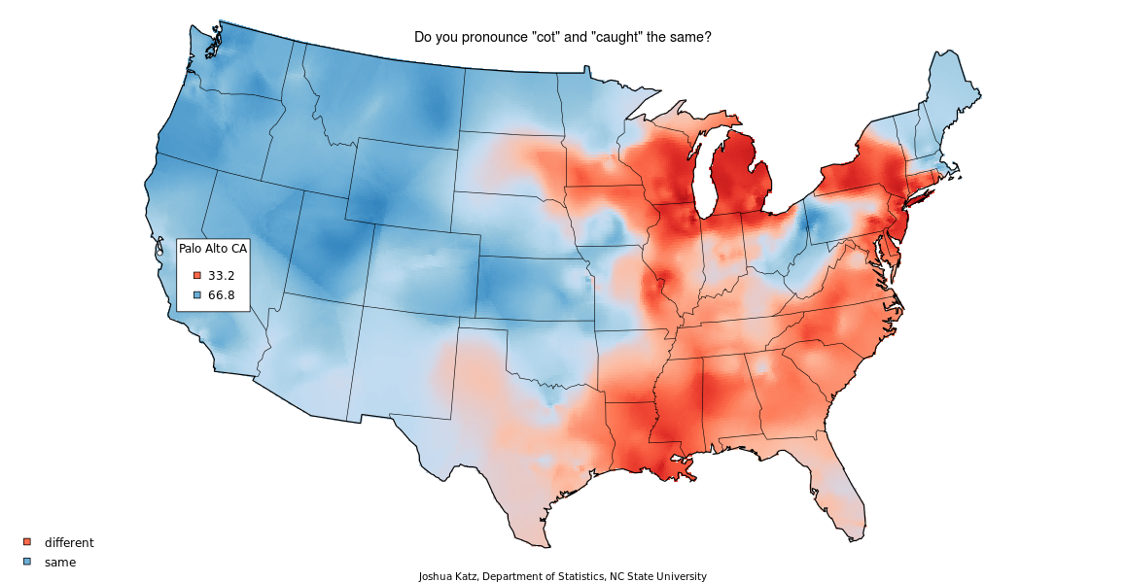
Phonetic variation: cot vs. caught

Slide 28
Syntactic variation
“The car needs washed” (Western Pennsylvania, Eastern Ohio, Northern West Virginia, Central Indiana)
“I am done my homework” (Canada, Philadelphia, Vermont, New Hampshire)

Slide 29
